Slide 1

Car Fault Diagnostic Mobile Application
This presentation explores the comprehensive system modeling and design for a Car Fault Diagnosis Mobile Application developed by the members of Group 18. The project demonstrates advanced system analysis techniques through multiple UML diagrams.
We will examine six critical diagrams that illustrate the application's architecture, functionality, and deployment strategy. Each diagram provides unique insights into different aspects of the system, from high-level context to detailed implementation structures.
By Group 18

Slide 2


Context Diagram Overview
Central System
External Entities
Data Exchange
The Car Fault Diagnosis System processes input data, analyzes fault codes, and provides diagnostic reports, repair tips, and cost estimates to various external entities.
Five key entities interact with the system: Car Owner/Driver, Mechanic, OBD-II Device, YouTube, and Stakeholders, each with specific input/output relationships.
Bidirectional communication occurs with users and mechanics, while OBD-II devices provide input only and YouTube provides output only for repair videos.

Slide 3
Level 1 Data Flow Diagram
1
Automatic Diagnostic
Retrieves data from OBD-2 device and forwards fault codes to interpretation and diagnostic units for automated analysis.
2
Manual Diagnostic
Accepts user-input symptoms and forwards them to the diagnostic unit for comprehensive fault analysis and interpretation.
3
Code Interpretation
Sends retrieved OBD-2 codes to the database for interpretation and displays human-readable explanations to users.
4
Maintenance Display
Shows relevant maintenance instructions and repair tutorials using database information and YouTube API integration.

Slide 4
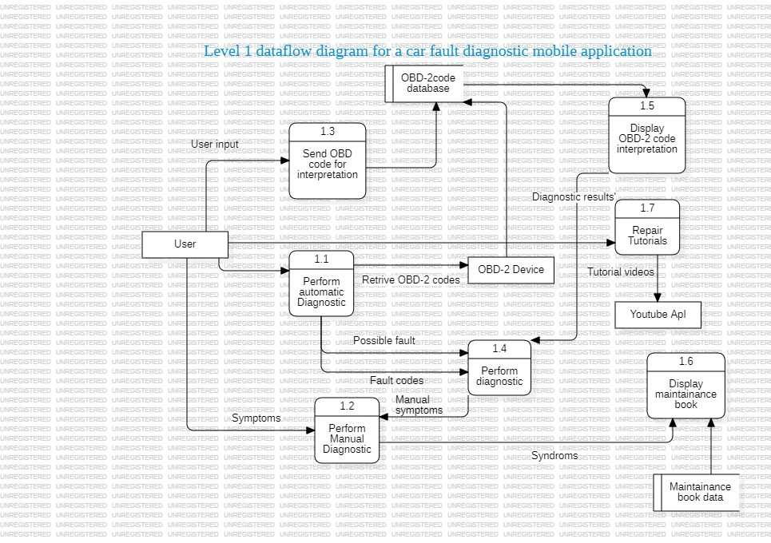

Slide 5
System Interactions
1
User Initiation
Diagnostic request via mobile app
2
Data Collection
Bluetooth OBD2 scanner connection
3
Server Processing
Code interpretation and analysis
4
Result Display
Diagnostic results and tutorials

Slide 6
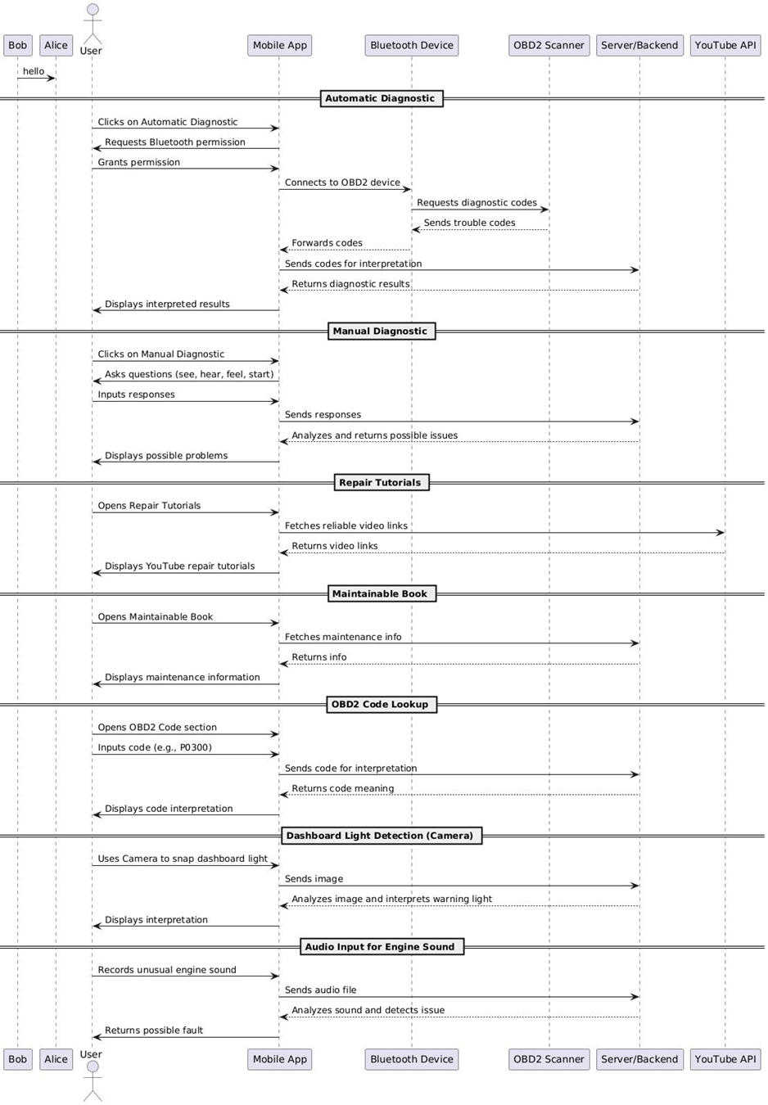

Slide 7
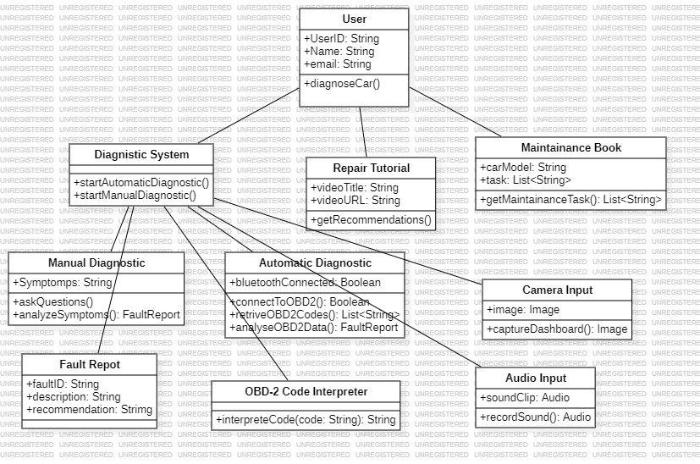
Class Structure
User Class
DiagnosticSystem
userID, name, email, preferences, diagnoseCar()
Automatic/manual diagnosis, code interpretation
Preferences
Preferred mode and language settings

Slide 8
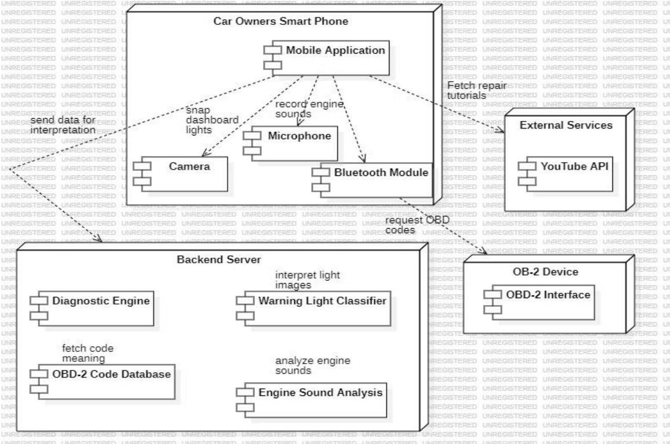
Deployment Architecture
Mobile Device
Backend Server
OBD-2 Device
App, camera, microphone, Bluetooth
Diagnostic engine, databases, analysis
Vehicle interface and data retrieval

Slide 9




Use Case Diagram Analysis
Primary Actor
User initiates all interactions
Diagnostic Functions
Automatic and manual diagnosis options
Input Methods
Visual, auditory, and haptic symptoms
Support Features
Repair tutorials and maintenance guides
The diagram models interactions between users and the Car Fault Mobile Application, including diagnostic capabilities, repair content access, and interpretation of OBD-2 codes, dashboard warning lights, and engine sounds. Include relationships show mandatory dependencies between use cases, ensuring proper system flow and precondition fulfillment.

Slide 10
